Slide 1
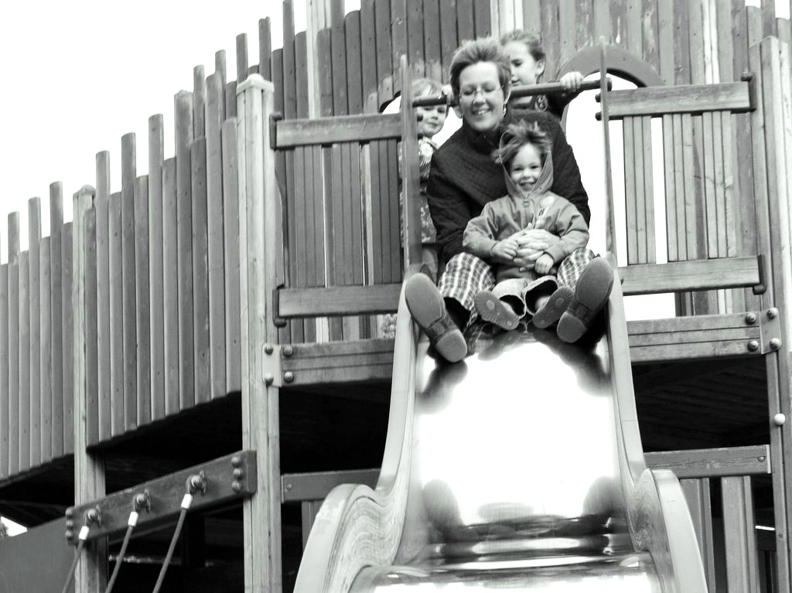

What
Is
Joint
Action?

Slide 2
What
Is
Joint
Action?
‘joint action [is] any form of social interaction whereby two or more individuals coordinate their actions in space and time to bring about a change in the environment.’
(Sebanz, Bekkering & Knoblich 2006: 70)

Slide 3
What
Is
Joint
Action?
‘joint action [is] any form of social interaction whereby two or more individuals coordinate their actions in space and time to bring about a change in the environment.’
(Sebanz, Bekkering & Knoblich 2006: 70)

Slide 4
What
Is
Joint
Action?
‘joint action [is] any form of social interaction whereby two or more individuals coordinate their actions in space and time to bring about a change in the environment.’
(Sebanz, Bekkering & Knoblich 2006: 70)

Slide 5
What
Is
Joint
Action?
‘joint action [is] any form of social interaction whereby two or more individuals coordinate their actions in space and time to bring about a change in the environment.’
(Sebanz, Bekkering & Knoblich 2006: 70)

Slide 6
What
Is
Joint
Action?
‘joint action [is] any form of social interaction whereby two or more individuals coordinate their actions in space and time to bring about a change in the environment.’
(Sebanz, Bekkering & Knoblich 2006: 70)

Slide 7
‘I take a collective action to involve a collective [shared] intention.’
(Gilbert 2006, p. 5)
What
Is
Joint
Action?
‘The sine qua non of collaborative action is a joint goal [shared intention]’
(Tomasello 2008, p. 181)
‘joint action [is] any form of social interaction whereby two or more individuals coordinate their actions in space and time to bring about a change in the environment.’
(Sebanz, Bekkering & Knoblich 2006: 70)
‘the key property of joint action lies in its internal component [...] in the participants’ having a [...] “shared” intention.’
(Alonso 2009, pp. 444-5)

Slide 8
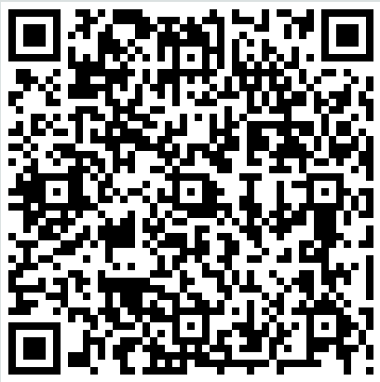
‘I take a collective action to involve a collective [shared] intention.’
(Gilbert 2006, p. 5)
What
Is
Joint
Action?
‘The sine qua non of collaborative action is a joint goal [shared intention]’
(Tomasello 2008, p. 181)
‘joint action [is] any form of social interaction whereby two or more individuals coordinate their actions in space and time to bring about a change in the environment.’
(Sebanz, Bekkering & Knoblich 2006: 70)
‘the key property of joint action lies in its internal component [...] in the participants’ having a [...] “shared” intention.’
(Alonso 2009, pp. 444-5)
http://goo.gl/wShK8

Slide 9
‘I take a collective action to involve a collective [shared] intention.’
(Gilbert 2006, p. 5)
What
Is
Joint
Action?
‘The sine qua non of collaborative action is a joint goal [shared intention]’
(Tomasello 2008, p. 181)
‘joint action [is] any form of social interaction whereby two or more individuals coordinate their actions in space and time to bring about a change in the environment.’
(Sebanz, Bekkering & Knoblich 2006: 70)
‘the key property of joint action lies in its internal component [...] in the participants’ having a [...] “shared” intention.’
(Alonso 2009, pp. 444-5)
http://goo.gl/wShK8

Slide 10
‘I take a collective action to involve a collective [shared] intention.’
(Gilbert 2006, p. 5)
What
Is
Joint
Action?
‘The sine qua non of collaborative action is a joint goal [shared intention]’
(Tomasello 2008, p. 181)
‘joint action [is] any form of social interaction whereby two or more individuals coordinate their actions in space and time to bring about a change in the environment.’
(Sebanz, Bekkering & Knoblich 2006: 70)
‘The key question in the philosophy of collective action is simply ... under what conditions are two or more people doing something together’
(Gilbert 2010: 67)
‘the key property of joint action lies in its internal component [...] in the participants’ having a [...] “shared” intention.’
(Alonso 2009, pp. 444-5)

Slide 11
‘I take a collective action to involve a collective [shared] intention.’
(Gilbert 2006, p. 5)
What
Is
Joint
Action?
‘The sine qua non of collaborative action is a joint goal [shared intention]’
(Tomasello 2008, p. 181)
‘joint action [is] any form of social interaction whereby two or more individuals coordinate their actions in space and time to bring about a change in the environment.’
(Sebanz, Bekkering & Knoblich 2006: 70)
‘The key question in the philosophy of collective action is simply ... under what conditions are two or more people doing something together’
(Gilbert 2010: 67)
‘The key question in the philosophy of collective action is simply ... under what conditions are two or more people doing something together’
(Gilbert 2010: 67)
‘the key property of joint action lies in its internal component [...] in the participants’ having a [...] “shared” intention.’
(Alonso 2009, pp. 444-5)

Slide 12
‘I take a collective action to involve a collective [shared] intention.’
(Gilbert 2006, p. 5)
What
Is
Joint
Action?
‘The sine qua non of collaborative action is a joint goal [shared intention]’
(Tomasello 2008, p. 181)
‘joint action [is] any form of social interaction whereby two or more individuals coordinate their actions in space and time to bring about a change in the environment.’
(Sebanz, Bekkering & Knoblich 2006: 70)
‘The key question in the philosophy of collective action is simply ... under what conditions are two or more people doing something together’
(Gilbert 2010: 67)
‘The key question in the philosophy of collective action is simply ... under what conditions are two or more people doing something together’
(Gilbert 2010: 67)
‘the key property of joint action lies in its internal component [...] in the participants’ having a [...] “shared” intention.’
(Alonso 2009, pp. 444-5)
Notes:
maybe our question should be simply, What is action? Maybe attempts to explain joint action fail because we start by assuming that real actions involve just one agents and provide an account of action on that basis; and having excluded joint action at the outset, it proves difficult to get it back into the account at a later stage.

Slide 13
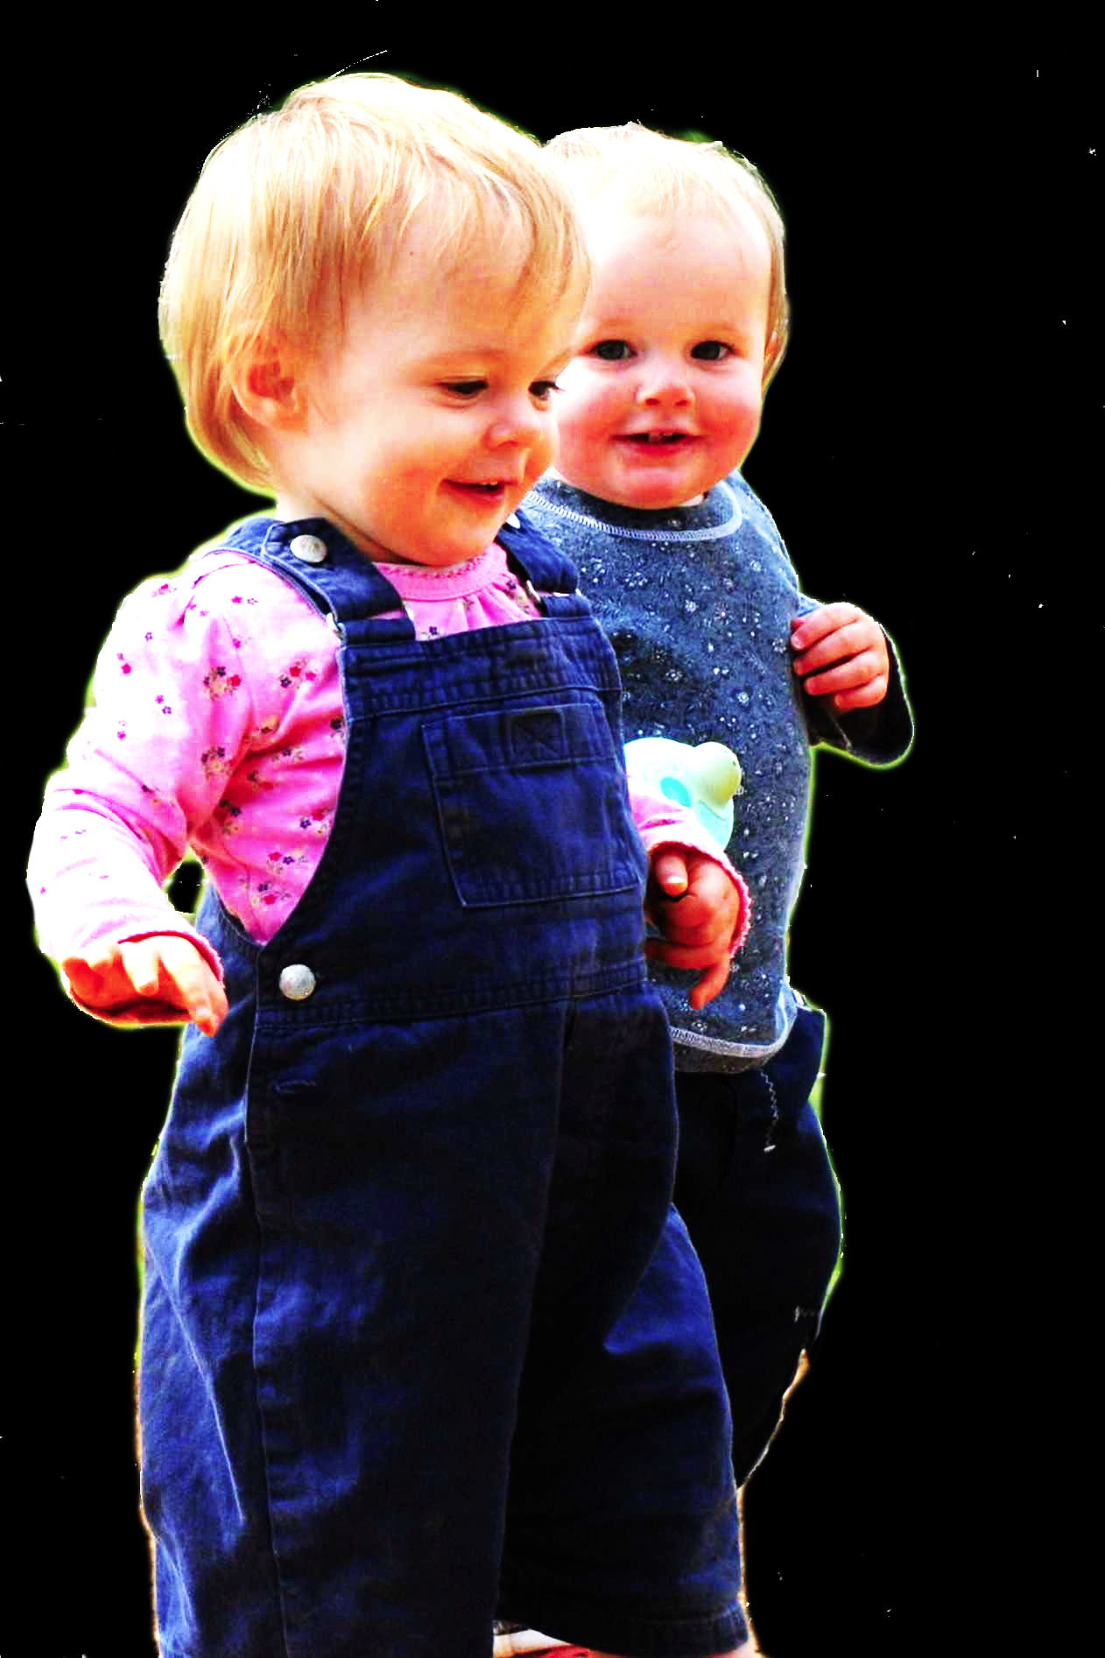
challenge
Show that a notion of joint action is already contained in a notion of action.

Slide 14
Joint action:
an action with two or more agents (Ludwig 2007)
Notes:
This avoids the Mistake.
But is it adequate?
Well, what does it have to be adequate to?

Slide 15
Joint action:
an action with two or more agents (Ludwig 2007)
Feline action:
an action whose agents include cats
Notes:
This avoids the Mistake.
But is it adequate?
Well, what does it have to be adequate to?

Slide 16
Joint action:
an action with two or more agents (Ludwig 2007)
painting a house together
(Bratman 1992)
tidying up the toys together
(Behne et al 2005)
lifting a heavy sofa together
(Velleman 1997)
cooperatively pulling handles in sequence to make a dog-puppet sing
(Brownell et al 2006)
bouncing a ball on a large trampoline together
(Tomasello & Carpenter 2007)
preparing a hollandaise sauce together
(Searle 1990)
...
Feline action:
an action whose agents include cats
Notes:
Most philosophers (and many psychologists) anchor their research using examples of joint action.
It has to be adequate to these examples.
These examples are not supposed to be merely cases of joint action, whatever that is.
They are also supposed to be paradigm cases,
and they are supposed to be cases reflection on which could provide an intuitive understanding of what joint action is.
The assumption is that there is some thing (at least one but not necessarily only one) of which many or all of these cases are indeed paradigm instances.
A notion of joint action is a notion of This is one criterion of adequacy.

Slide 17
challenge
Show that a notion of joint action is already contained in a notion of action.
constraint
Any notion of joint action is
(a) central to a tangle of philo-sophical and scientific questions commonly taken to be questions about joint action, and
(b) such that an implicit conception of it is available through reflection on many or all of the cases commonly taken to be paradigmatic.

Slide 18
Joint action:
an action with two or more agents (Ludwig 2007)
painting a house together
(Bratman 1992)
tidying up the toys together
(Behne et al 2005)
lifting a heavy sofa together
(Velleman 1997)
cooperatively pulling handles in sequence to make a dog-puppet sing
(Brownell et al 2006)
bouncing a ball on a large trampoline together
(Tomasello & Carpenter 2007)
preparing a hollandaise sauce together
(Searle 1990)
...
Notes:
Most philosophers (and many psychologists) anchor their research using examples of joint action.
It has to be adequate to these examples.
These examples are not supposed to be merely cases of joint action, whatever that is.
They are also supposed to be paradigm cases,
and they are supposed to be cases reflection on which could provide an intuitive understanding of what joint action is.
The assumption is that there is some thing (at least one but not necessarily only one) of which many or all of these cases are indeed paradigm instances.
A notion of joint action is a notion of This is one criterion of adequacy.

Slide 19
Joint action:
an action with two or more agents (Ludwig 2007)
painting a house together
(Bratman 1992)
tidying up the toys together
(Behne et al 2005)
lifting a heavy sofa together
(Velleman 1997)
cooperatively pulling handles in sequence to make a dog-puppet sing
(Brownell et al 2006)
bouncing a ball on a large trampoline together
(Tomasello & Carpenter 2007)
preparing a hollandaise sauce together
(Searle 1990)
...

Slide 20
Joint action:
an action with two or more agents (Ludwig 2007)
‘our primitive actions, the ones we do not by doing something else, ... these are all the actions there are.’ (Davidson 1971, p. 59).
painting a house together
(Bratman 1992)
tidying up the toys together
(Behne et al 2005)
lifting a heavy sofa together
(Velleman 1997)
cooperatively pulling handles in sequence to make a dog-puppet sing
(Brownell et al 2006)
bouncing a ball on a large trampoline together
(Tomasello & Carpenter 2007)
preparing a hollandaise sauce together
(Searle 1990)
...

Slide 21
Joint action:
an action with two or more agents (Ludwig 2007)
‘our primitive actions, the ones we do not by doing something else, ... these are all the actions there are.’ (Davidson 1971, p. 59).
painting a house together
(Bratman 1992)
tidying up the toys together
(Behne et al 2005)
lifting a heavy sofa together
(Velleman 1997)
cooperatively pulling handles in sequence to make a dog-puppet sing
(Brownell et al 2006)
bouncing a ball on a large trampoline together
(Tomasello & Carpenter 2007)
preparing a hollandaise sauce together
(Searle 1990)
...
move fingers
unlock door
turn key

Slide 22
Joint action:
an action with two or more agents (Ludwig 2007)
‘our primitive actions, the ones we do not by doing something else, ... these are all the actions there are.’ (Davidson 1971, p. 59).
painting a house together
(Bratman 1992)
tidying up the toys together
(Behne et al 2005)
lifting a heavy sofa together
(Velleman 1997)
cooperatively pulling handles in sequence to make a dog-puppet sing
(Brownell et al 2006)
bouncing a ball on a large trampoline together
(Tomasello & Carpenter 2007)
preparing a hollandaise sauce together
(Searle 1990)
...
move fingers
unlock door
turn key

Slide 23
Joint action:
an action with two or more agents (Ludwig 2007)
‘our primitive actions, the ones we do not by doing something else, ... these are all the actions there are.’ (Davidson 1971, p. 59).
move fingers
unlock door
turn key

Slide 24
Joint action:
an action with two or more agents (Ludwig 2007)
‘our primitive actions, the ones we do not by doing something else, ... these are all the actions there are.’ (Davidson 1971, p. 59).
tidying up the toys together
(Behne et al 2005)
cooperatively pulling handles in sequence to make a dog-puppet sing
(Brownell et al 2006)
bouncing a ball on a large trampoline together
(Tomasello & Carpenter 2007)
pretending to row a boat together
move fingers
unlock door
turn key

Slide 25
Joint action:
an action with two or more agents (Ludwig 2007)
‘our primitive actions, the ones we do not by doing something else, ... these are all the actions there are.’ (Davidson 1971, p. 59).
tidying up the toys together
(Behne et al 2005)
cooperatively pulling handles in sequence to make a dog-puppet sing
(Brownell et al 2006)
bouncing a ball on a large trampoline together
(Tomasello & Carpenter 2007)
pretending to row a boat together
move fingers
unlock door
turn key

Slide 26
Joint action:
an action with two or more agents (Ludwig 2007)
tidying up the toys together
(Behne et al 2005)
cooperatively pulling handles in sequence to make a dog-puppet sing
(Brownell et al 2006)
bouncing a ball on a large trampoline together
(Tomasello & Carpenter 2007)
pretending to row a boat together
my pulling
dog’s singing
your pulling
We make the dog sing

Slide 27
Joint action:
an action with two or more agents (Ludwig 2007)
tidying up the toys together
(Behne et al 2005)
cooperatively pulling handles in sequence to make a dog-puppet sing
(Brownell et al 2006)
bouncing a ball on a large trampoline together
(Tomasello & Carpenter 2007)
pretending to row a boat together
my pulling
dog’s singing
your pulling
We make the dog sing

Slide 28
Joint action:
an action with two or more agents (Ludwig 2007)
tidying up the toys together
(Behne et al 2005)
cooperatively pulling handles in sequence to make a dog-puppet sing
(Brownell et al 2006)
bouncing a ball on a large trampoline together
(Tomasello & Carpenter 2007)
pretending to row a boat together
my pulling
dog’s singing
your pulling
We make the dog sing

Slide 29
1
Joint action:
an action with two or more agents (Ludwig 2007)
Bodily movements ‘are all the actions there are’ (Davidson 1971, p. 59)
In supposedly paradigm cases of joint action, there are no bodily movements with more than one agent.
Therefore:
Supposedly paradigm cases are not joint actions.
tidying up the toys together
(Behne et al 2005)
cooperatively pulling handles in sequence to make a dog-puppet sing
(Brownell et al 2006)
bouncing a ball on a large trampoline together
(Tomasello & Carpenter 2007)
pretending to row a boat together
2
3
4

Slide 30
1
too narrow
Joint action:
an action with two or more agents (Ludwig 2007)
Bodily movements ‘are all the actions there are’ (Davidson 1971, p. 59)
In supposedly paradigm cases of joint action, there are no bodily movements with more than one agent.
Therefore:
Supposedly paradigm cases are not joint actions.
tidying up the toys together
(Behne et al 2005)
cooperatively pulling handles in sequence to make a dog-puppet sing
(Brownell et al 2006)
bouncing a ball on a large trampoline together
(Tomasello & Carpenter 2007)
pretending to row a boat together
2
3
4

Slide 31
Joint action:
an action with two or more agents (Ludwig 2007)

Slide 32
Joint action:
an action event with two or more agents (Ludwig 2007)

Slide 33
Joint action:
an action event with two or more agents (Ludwig 2007)
Grounding
events D₁, ... D_{n} ground E, if:
D₁, ... D_{n} and E occur;
D₁, ... D_{n} are each (perhaps improper) parts of E; and
every event that is a proper part of E but does not overlap D₁,...D_{n} is caused by some or all of D₁, ... D_{n}.
Agency
For an individual to be among the agents of an event is for there to be actions a₁, ... a_{n} which ground this event where the individual is an agent of one or more of these actions.
(Adapted from Pietroski 1998)

Slide 34
Joint action:
an action event with two or more agents (Ludwig 2007)
tidying up the toys together
(Behne et al 2005)
cooperatively pulling handles in sequence to make a dog-puppet sing
(Brownell et al 2006)
bouncing a ball on a large trampoline together
(Tomasello & Carpenter 2007)
pretending to row a boat together
my pulling
dog’s singing
your pulling
We make the dog sing

Slide 35
Joint action:
an action event with two or more agents (Ludwig 2007)
tidying up the toys together
(Behne et al 2005)
cooperatively pulling handles in sequence to make a dog-puppet sing
(Brownell et al 2006)
bouncing a ball on a large trampoline together
(Tomasello & Carpenter 2007)
pretending to row a boat together

Slide 36
Joint action:
an action event with two or more agents (Ludwig 2007)
tidying up the toys together
(Behne et al 2005)
cooperatively pulling handles in sequence to make a dog-puppet sing
(Brownell et al 2006)
bouncing a ball on a large trampoline together
(Tomasello & Carpenter 2007)
pretending to row a boat together
Nora’s shooting
Fred’s death
Olive’s shooting
Fred’s killing

Slide 37
too broad
Joint action:
an action event with two or more agents (Ludwig 2007)
tidying up the toys together
(Behne et al 2005)
cooperatively pulling handles in sequence to make a dog-puppet sing
(Brownell et al 2006)
bouncing a ball on a large trampoline together
(Tomasello & Carpenter 2007)
pretending to row a boat together
Nora’s shooting
Fred’s death
Olive’s shooting
Fred’s killing

Slide 38
challenge
Show that a notion of joint action is already contained in a notion of action.
constraint
Any notion of joint action is
(a) central to a tangle of philosophical and scientific questions commonly taken to be questions about joint action, and
(b) such that an implicit conception of it is available through reflection on many or all of the cases commonly taken to be paradigmatic.

Slide 39
too broad
Joint action:
an action event with two or more agents (Ludwig 2007)
tidying up the toys together
(Behne et al 2005)
cooperatively pulling handles in sequence to make a dog-puppet sing
(Brownell et al 2006)
bouncing a ball on a large trampoline together
(Tomasello & Carpenter 2007)
pretending to row a boat together
Nora’s shooting
Fred’s death
Olive’s shooting
Fred’s killing

Slide 40
too broad
Joint action:
an action event with two or more agents (Ludwig 2007)
tidying up the toys together
(Behne et al 2005)
cooperatively pulling handles in sequence to make a dog-puppet sing
(Brownell et al 2006)
bouncing a ball on a large trampoline together
(Tomasello & Carpenter 2007)
pretending to row a boat together
Nora’s shooting
Fred’s death
Olive’s shooting
Fred’s killing

Slide 41
Goal-directed joint action: an event with two or more agents which, taken as a whole, is directed to a goal.
tidying up the toys together
(Behne et al 2005)
cooperatively pulling handles in sequence to make a dog-puppet sing
(Brownell et al 2006)
bouncing a ball on a large trampoline together
(Tomasello & Carpenter 2007)
pretending to row a boat together
Nora’s shooting
Fred’s death
Olive’s shooting
Fred’s killing

Slide 42
Goal-directed joint action: an event with two or more agents which, taken as a whole, is directed to a goal.
tidying up the toys together
(Behne et al 2005)
cooperatively pulling handles in sequence to make a dog-puppet sing
(Brownell et al 2006)
bouncing a ball on a large trampoline together
(Tomasello & Carpenter 2007)
pretending to row a boat together
Nora’s shooting
Fred’s death
Olive’s shooting
Fred’s killing

Slide 43
Goal-directed joint action: an event with two or more agents which, taken as a whole, is directed to a goal.
out
out
act
out
act
out

Slide 44
Goal-directed joint action: an event with two or more agents which, taken as a whole, is directed to a goal.
out
out
act
represents
coordinates
out
act
shared intention
out

Slide 45
Goal-directed joint action: an event with two or more agents which, taken as a whole, is directed to a goal.
???
out
out
act
represents
coordinates
out
act
shared intention
out

Slide 46
Goal-directed joint action: an event with two or more agents which, taken as a whole, is directed to a goal.
G is a distributive goal
(a) it is an outcome to which each action is individually directed; and
(b) it is possible that: all actions succeed relative to this outcome.

Slide 47
Goal-directed joint action: an event with two or more agents which, taken as a whole, is directed to a goal.
G is a distributive goal
(a) it is an outcome to which each action is individually directed; and
(b) it is possible that: all actions succeed relative to this outcome.
G is a collective goal
(a) it is a distributive goal;
(b) the actions are coordinated; and
(c) coordination of this type would normally facilitate occurrences of outcomes of G’s type.

Slide 48
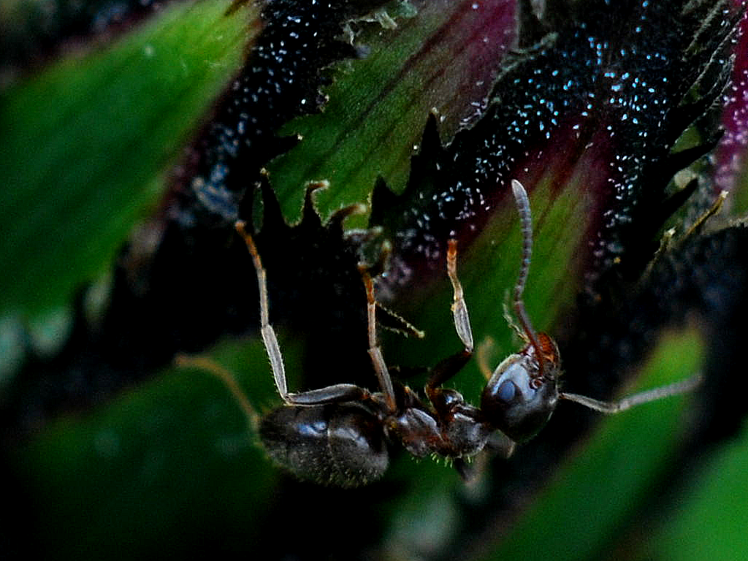

Slide 49
sting
sting
sting
sting
sting
death of fly
sting
sting
sting

Slide 50
challenge
Show that a notion of joint action is already contained in a notion of action.

Slide 51
challenge
Show that a notion of joint action is already contained in a notion of action.
constraint
Any notion of joint action is
(a) central to a tangle of philosophical and scientific questions commonly taken to be questions about joint action, and
(b) such that an implicit conception of it is available through reflection on many or all of the cases commonly taken to be paradigmatic.

Slide 52
challenge
Show that a notion of joint action is already contained in a notion of action.
constraint
Any notion of joint action is
(a) central to a tangle of philosophical and scientific questions commonly taken to be questions about joint action, and
(b) such that an implicit conception of it is available through reflection on many or all of the cases commonly taken to be paradigmatic.
solution
A goal-directed joint action is an event grounded by two or more agents’ actions where these actions have a collective goal.

Slide 53
What
Is
Joint
Action?

